Slide 1
What is the Best Movie to Make?
Ulysses Palomar, Collin Kravig, Pierre Vasquez, Sam Bauer

Slide 2
Our Data
256 movies
Made money in 2017
i.e. Terminator 2 (1991)
Distributor
Genre
Rating
2017 Gross
Tickets sold
https://www.the-numbers.com/market/2017/top-grossing-movies

Slide 3
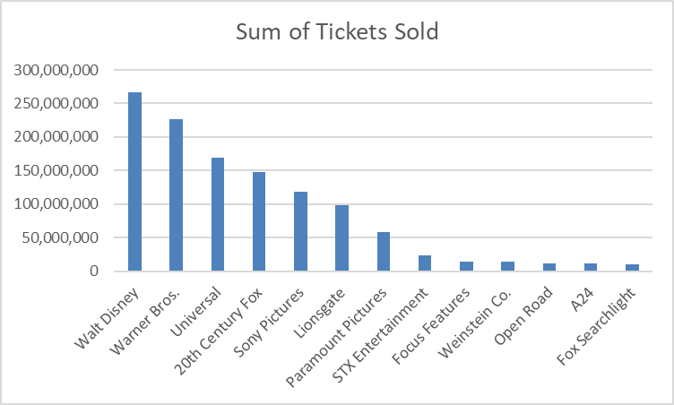
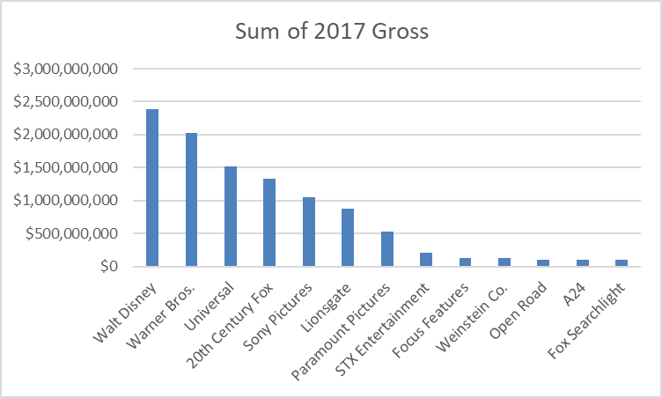
Distributors

Slide 4





Top Distributors

Slide 5





Walt Disney
Warner Bros.
Notes:
Star Wars Ep. VIII: The Last Jedi and Beauty and the Beast made up 40% of Disney’s total gross. Each movie generated $500 million

Slide 6
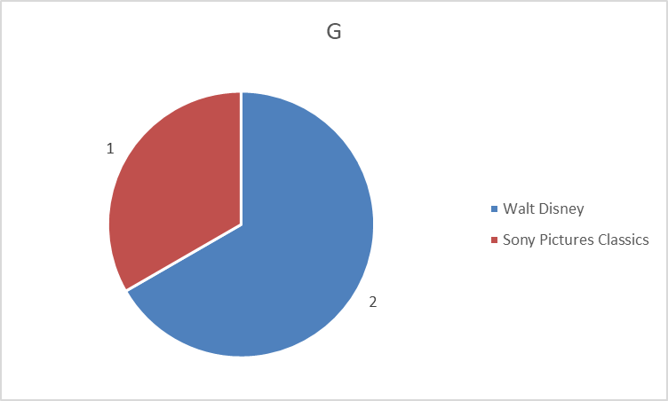
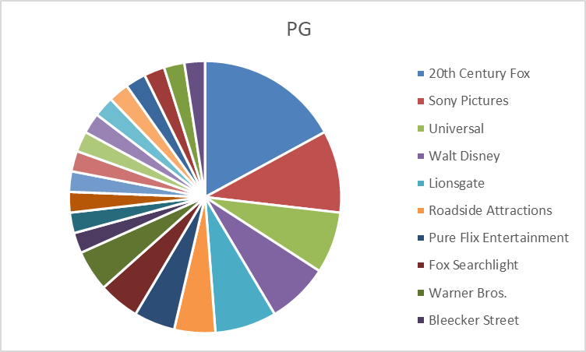
Rating
Cars 3
Born in China
The Eagle Huntress

Slide 7
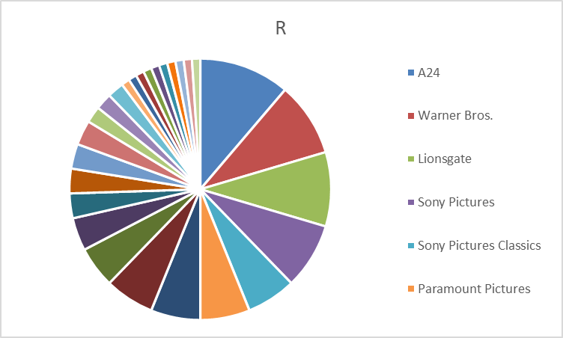
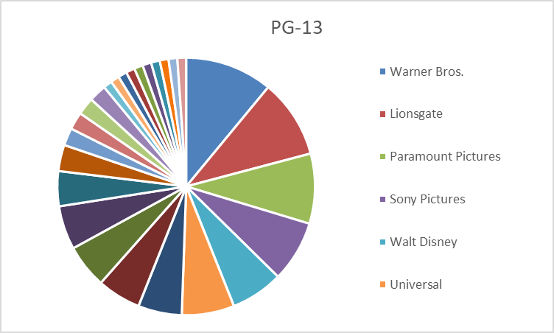
Rating
A24 only made R movies
Drama and Horror
Disney never made an R movie

Slide 8
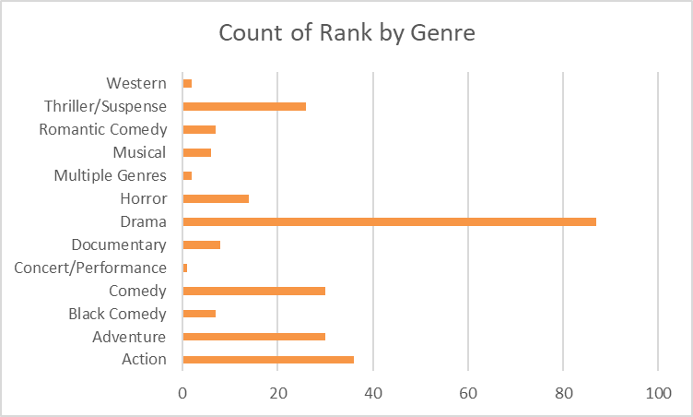
Genres

Slide 9
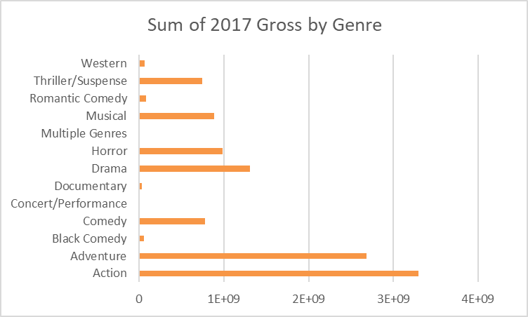
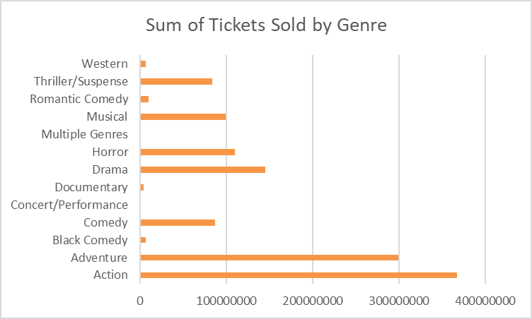
Genres

Slide 10



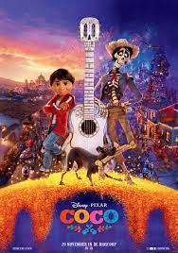
Top Genres
Action
Adventure
Drama
Musical

Slide 11
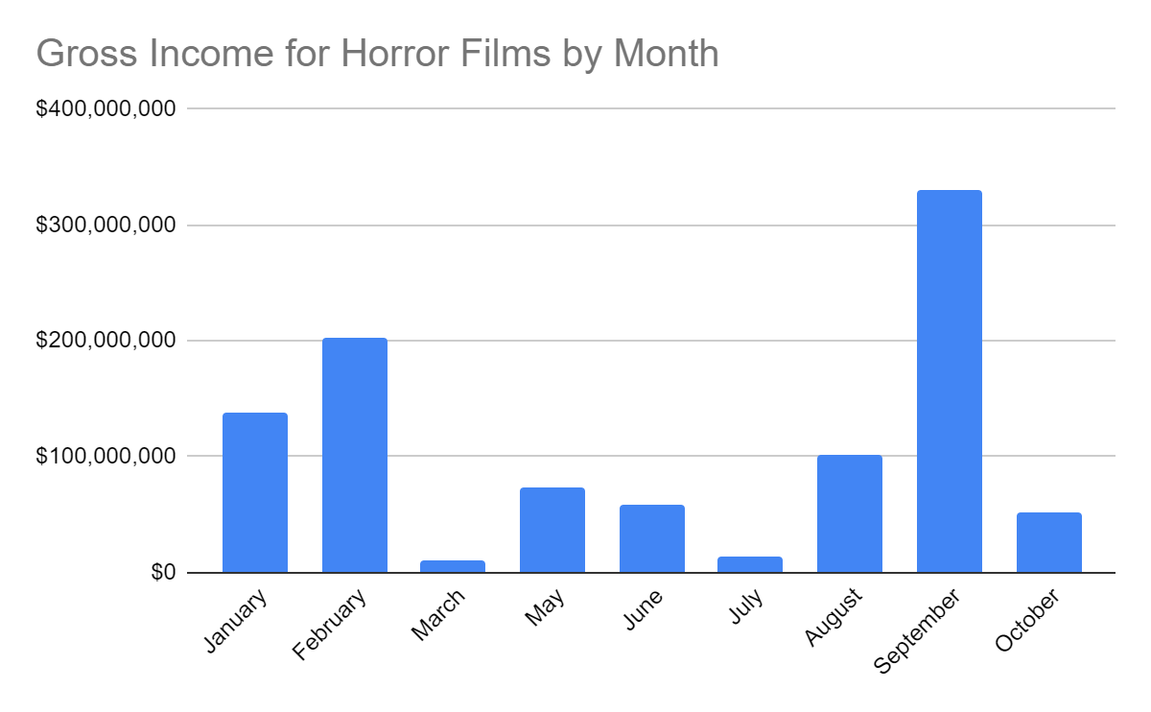
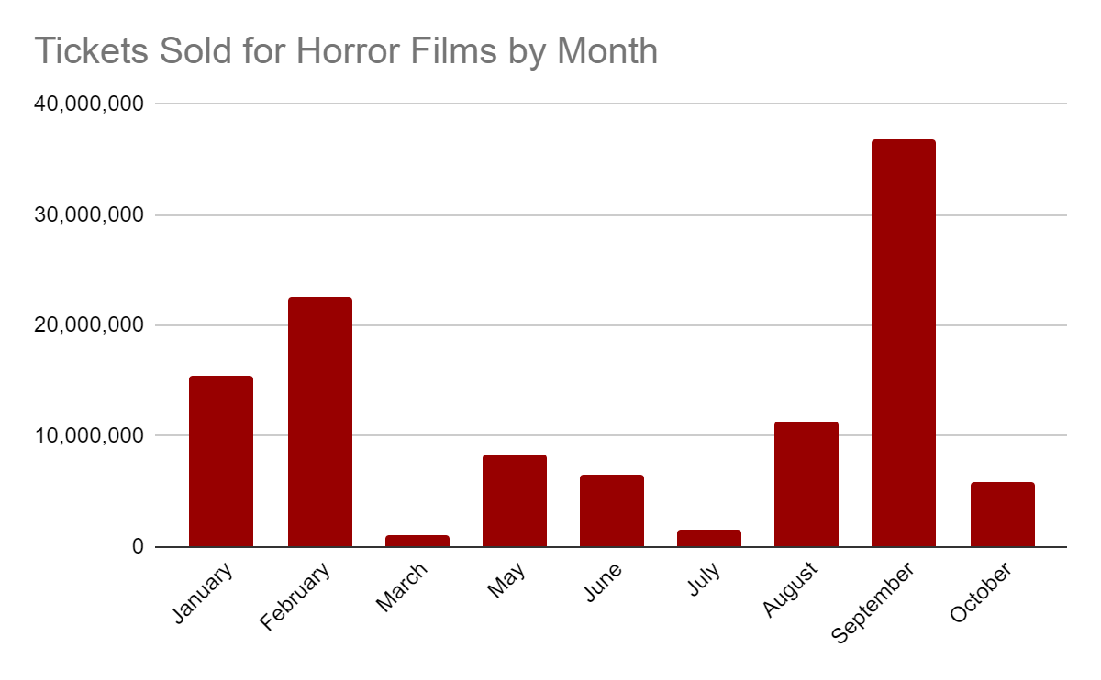
Horror Films | Best Month for Release

Slide 12
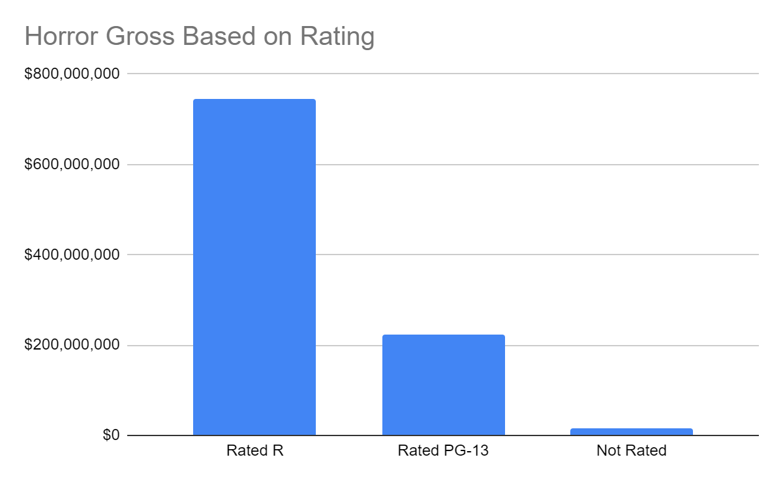
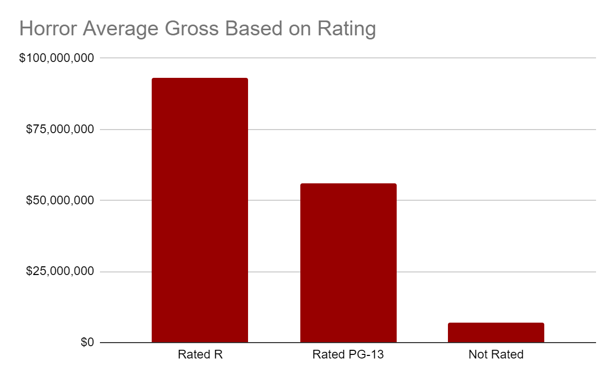
Horror Films | Ratings
Half as many PG-13 as R rated Horror films

Slide 13



Top Horror Films
1.
R
2.
R
3.
PG-13

Slide 14
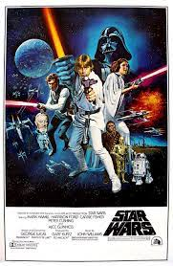

Comparing Movie Sales with Their Sequels

Slide 15
Assumption
With new releases each movie will earn less

Slide 16
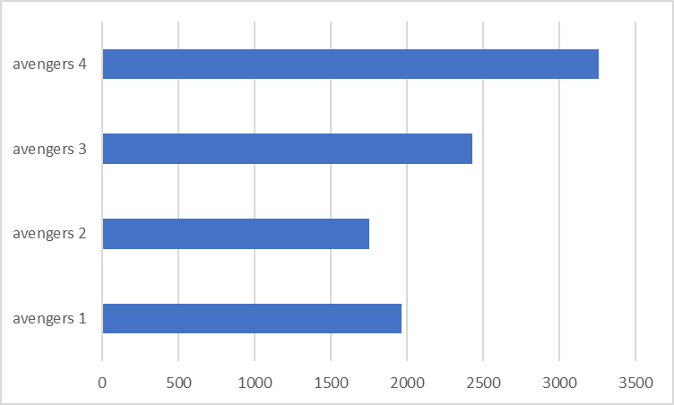
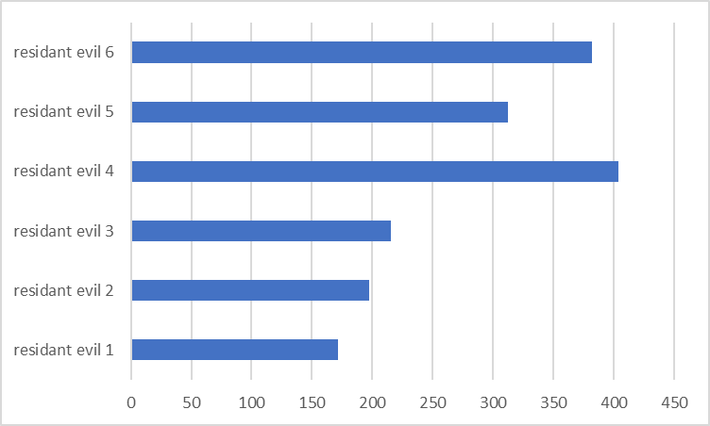

Slide 17
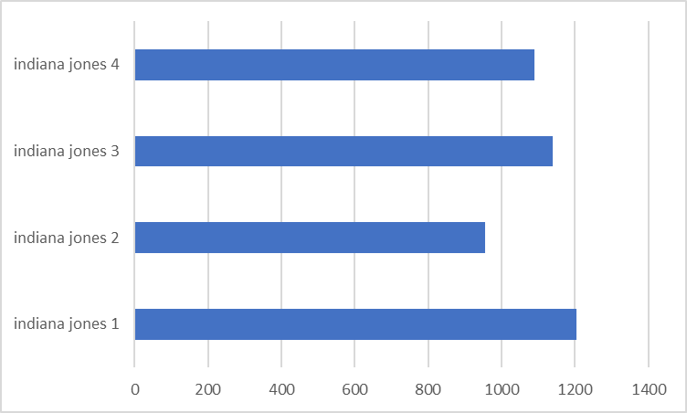
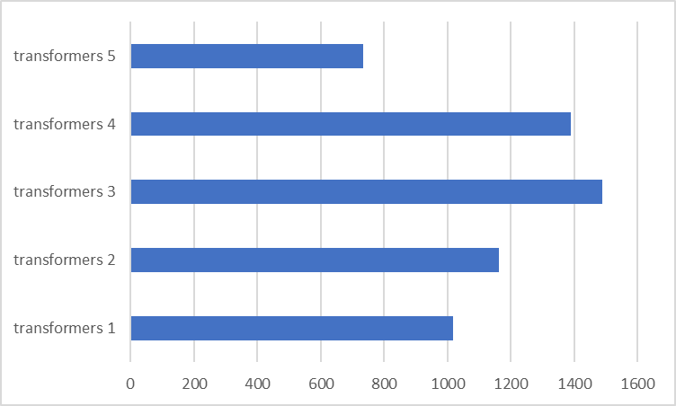

Slide 18
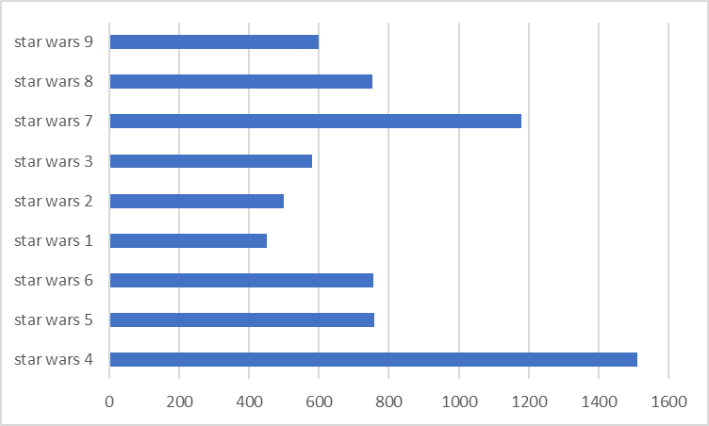
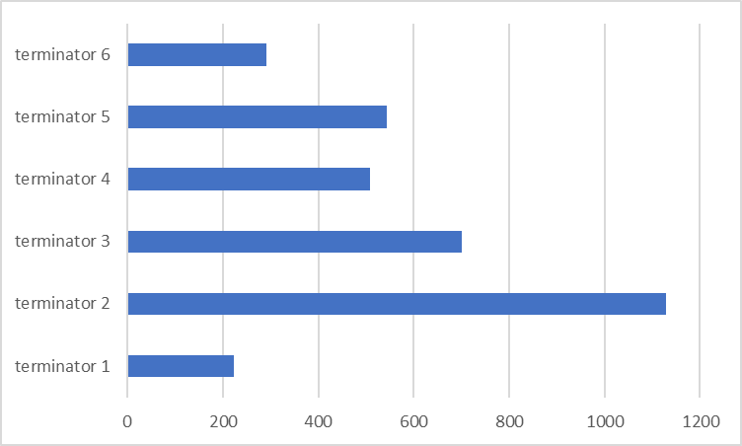

Slide 19
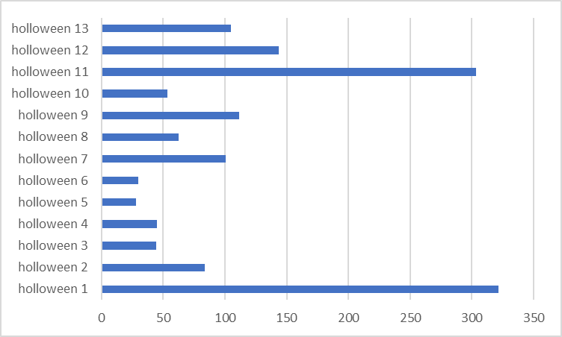

Slide 20
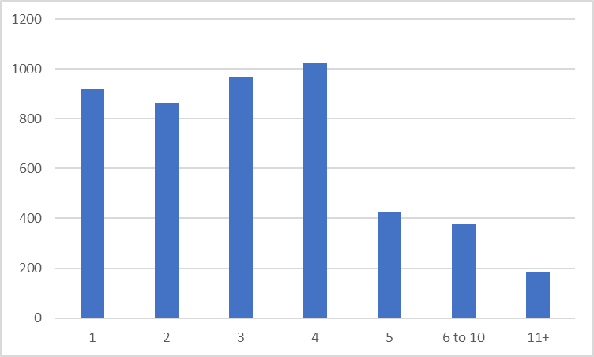
Average

Slide 21
Lacking Data
We believe this data set is a little lacking.
Some more data points such as:
Budget (How much they could spend on the movie)
Production Time (How long they spent making the movie)
Sequel,Remake/Remaster (If the movie is tied to an existing movie)
Release Type (If the movie was released on streaming before theater)

Slide 22
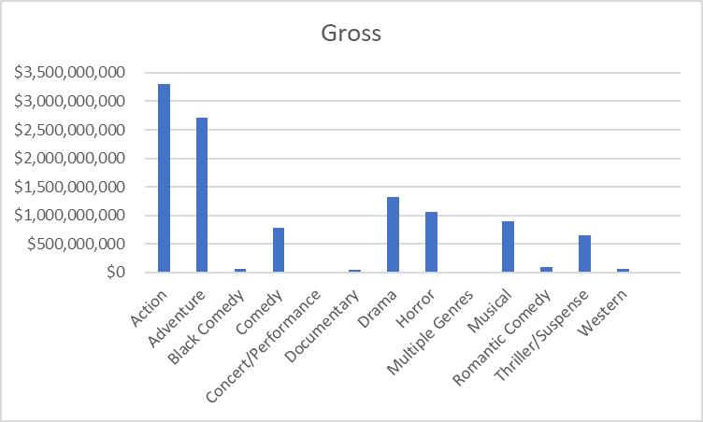
What is the best genre to profit from?
More drama movies than action movies
Action created the most revenue

Slide 23

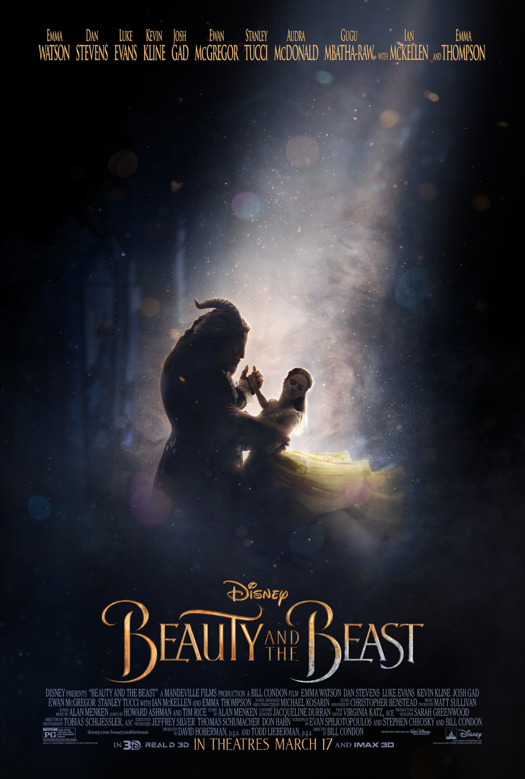

Top 3 Movies based on gross
1
2
3
Star Wars Ep. VIII: The Last Jedi
Adventure
Beauty and The Beast
Musical
Wonder Woman
Action

Slide 24


Action
Action is on a trend upwards.
Does not guarantee success, but shows it has a higher chance to succeed.

Slide 25
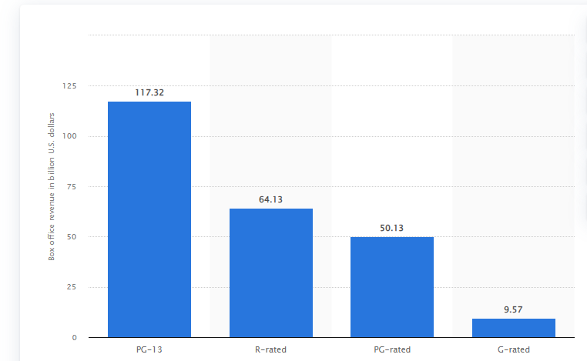
Which movie rating brings the most revenue?
1995-2022
https://www.statista.com/statistics/433709/highest-grossing-movies-domestic-box-office-rating/#:~:text=Between%201995%20and%20July%202022,and%2050%20billion%20dollars%2C%20respectively.

Slide 26

PG-13
More accessible
Lower age restriction
Tend to have superheroes and action

